Slide 1

A.A.GOVERNMENT ARTS COLLEGE, MUSIRI. Affiliated to Bharathidasan University , Tiruchirappalli. NAAN MUDHALVAN PROJECT – III B.SC MATHEMATICS
VOYAGE VISTA : ILLUMINATING INSIGHTS FROM UBER EXPEDITIONARY ANALYSIS
Submitted by
TEAM ID: NM2023TMID08496
TEAM LEADER: SURYA M [7A8F8EFBE1055E9988F49A3D104C7E40]
MEMBER 1: THARANITHARAN S [A97768794A1E51F805648A7B1EEB99EE]
MEMBER 2: PREM B [DD2656629D0AC358D46495F129665398]
MEMBER 3: KAMALRAJ T [E221FD5A08FB2A5907C481F9C746A7A9]

Slide 2
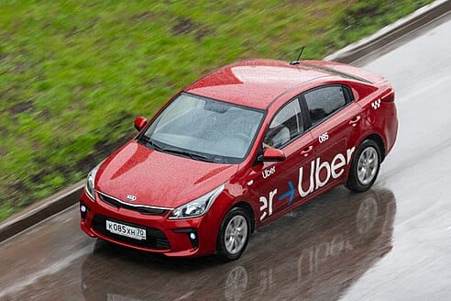
INTRODUCTION
Uber is a multinational transportation network company that operates a ride-hailing platform. It was founded in 2009 by Garrett Camp and Travis Kalanick and is based in San Francisco, California. Uber provides a convenient way for individuals to request rides from drivers who use their own personal vehicles. Uber Driver Analysis refers to the Analyzing the number of trips taken by Uber drivers can provide insights into their overall activity and
the demand for rides in specific areas. Daily, Weekly, or Monthly Analysis: Uber's data can be analyzed on a daily,weekly, monthly basis to understand the trends and patterns of trip volumes.

Slide 3
REFERENCE
Uber Technologies, Inc. (commonly referred to as Uber) provides ride-hailing services, food delivery, and freight transport. It is headquartered in San Francisco and operates in approximately 70 countries and 10,500 cities worldwide. The company has over 131 million monthly active users and 6 million active drivers and couriers worldwide and facilitates an average of 25 million trips per day. It has facilitated 42 billion trips since its inception in 2010 and is the largest ridesharing company in the United States.

Slide 4
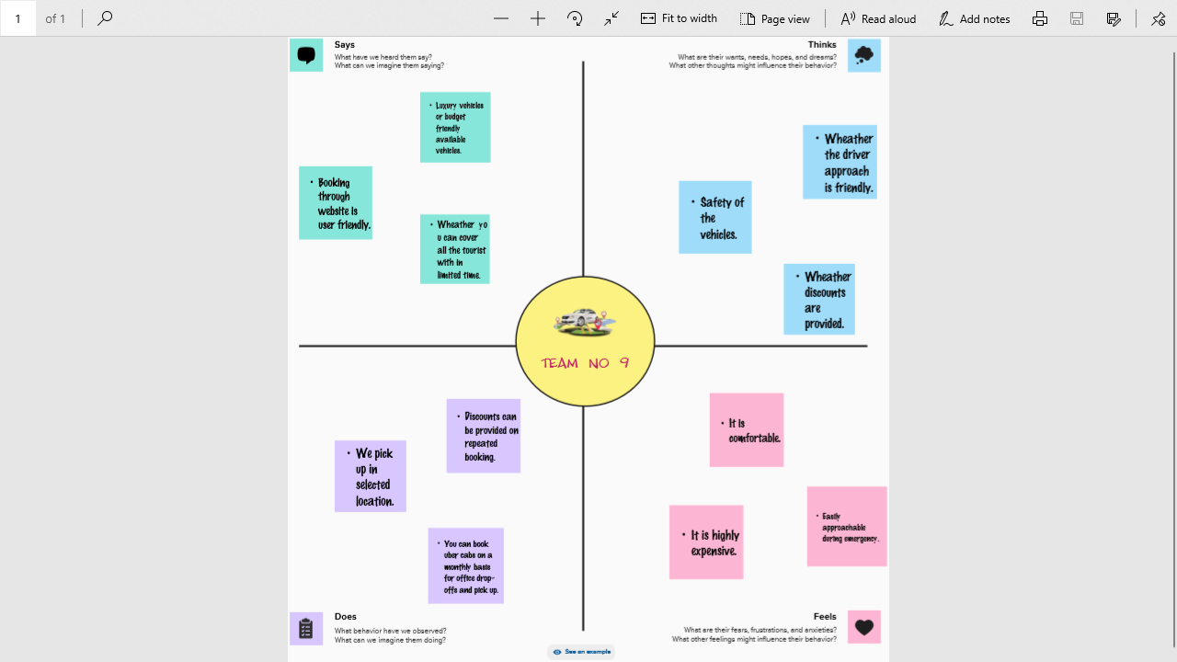
EMPATHY MAP

Slide 5
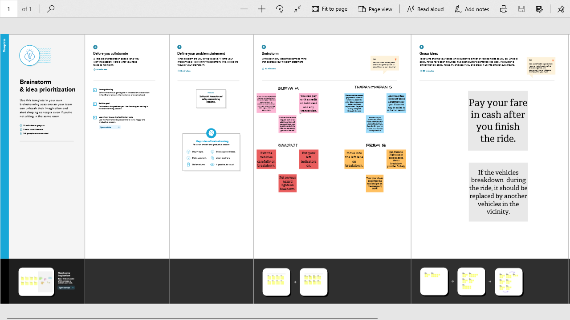
BRAINSTORM

Slide 6
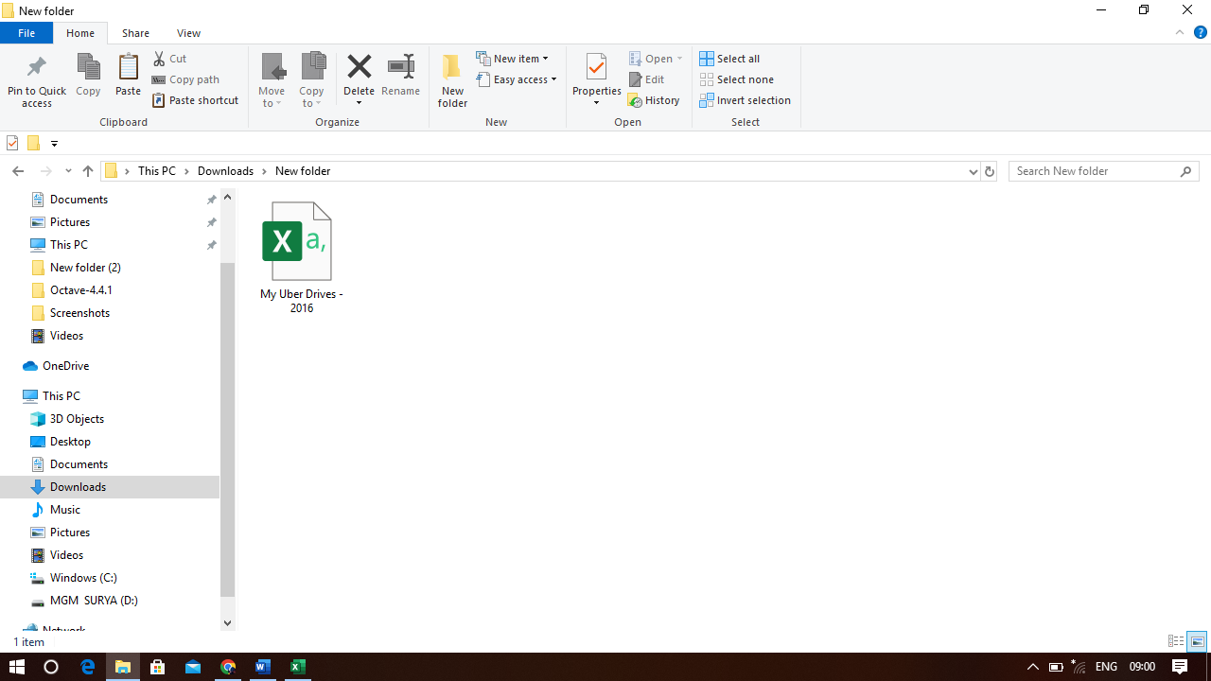
Data Collection

Slide 7
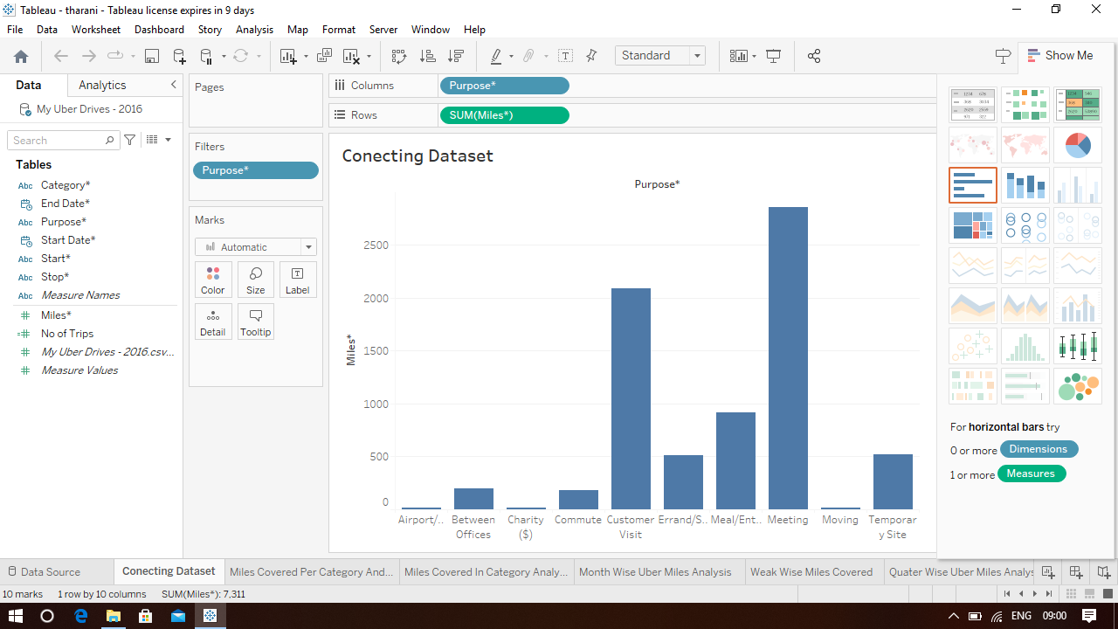
DATA VISUALIZATION
Connect Dataset with Tableau

Slide 8
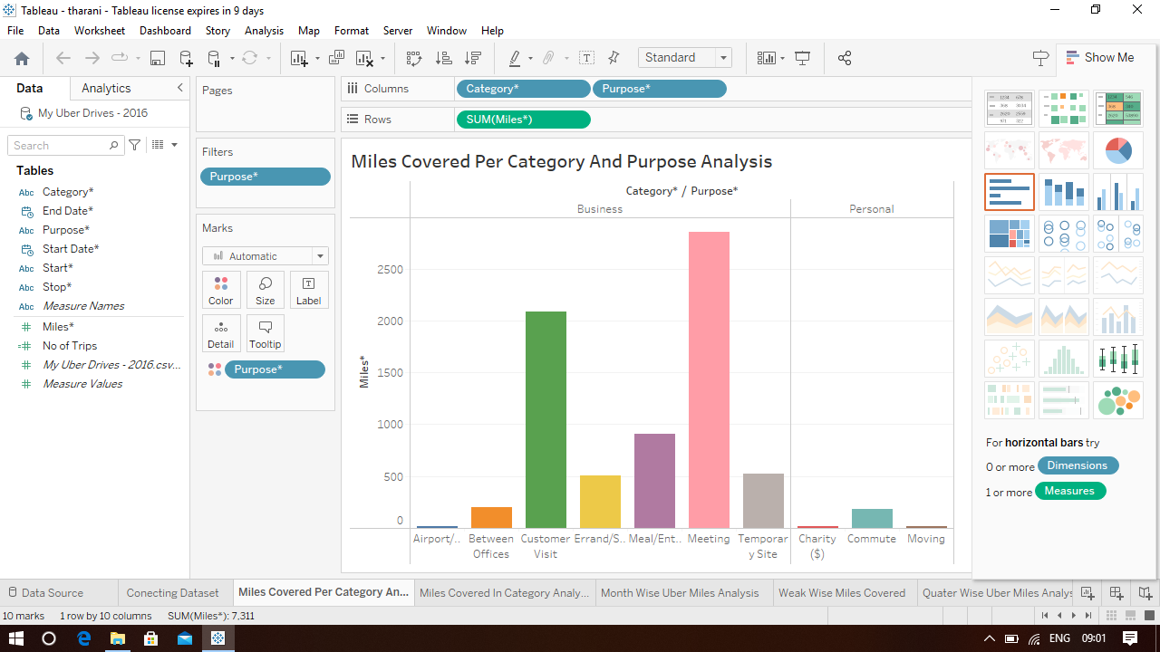
Miles Covered per category and Purpose Analysis

Slide 9
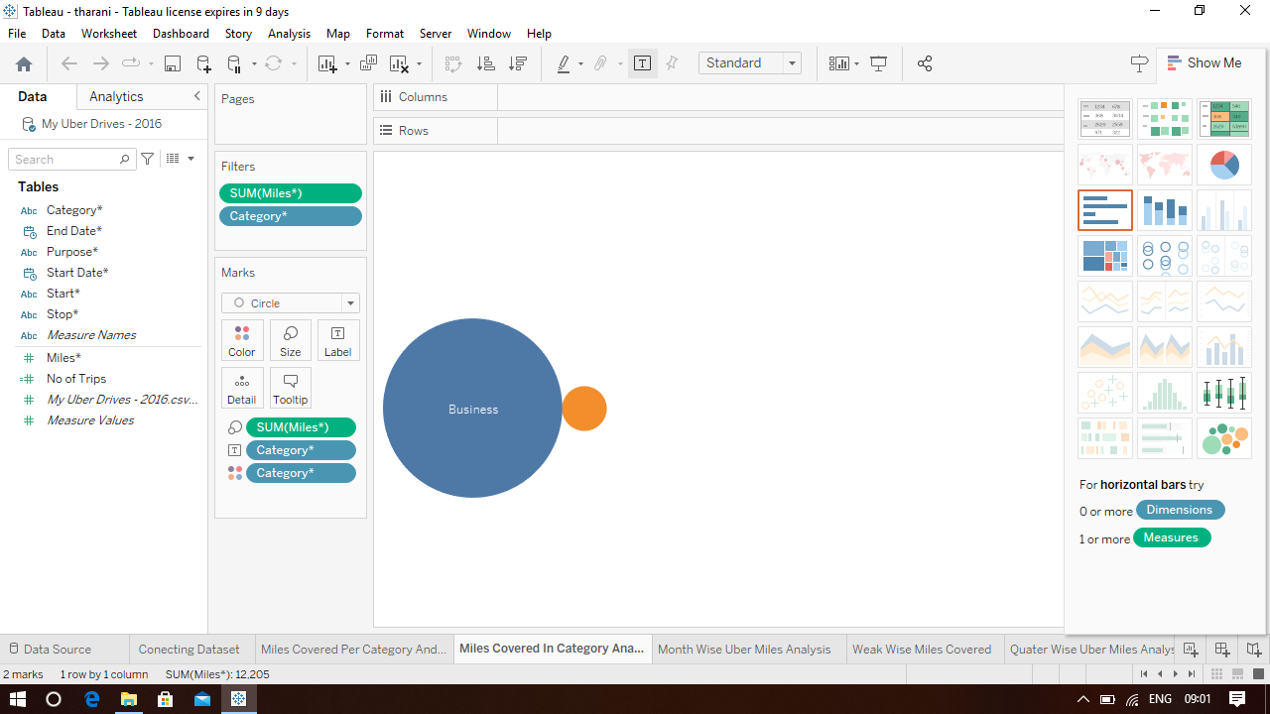
Miles covered in Category Analysis

Slide 10
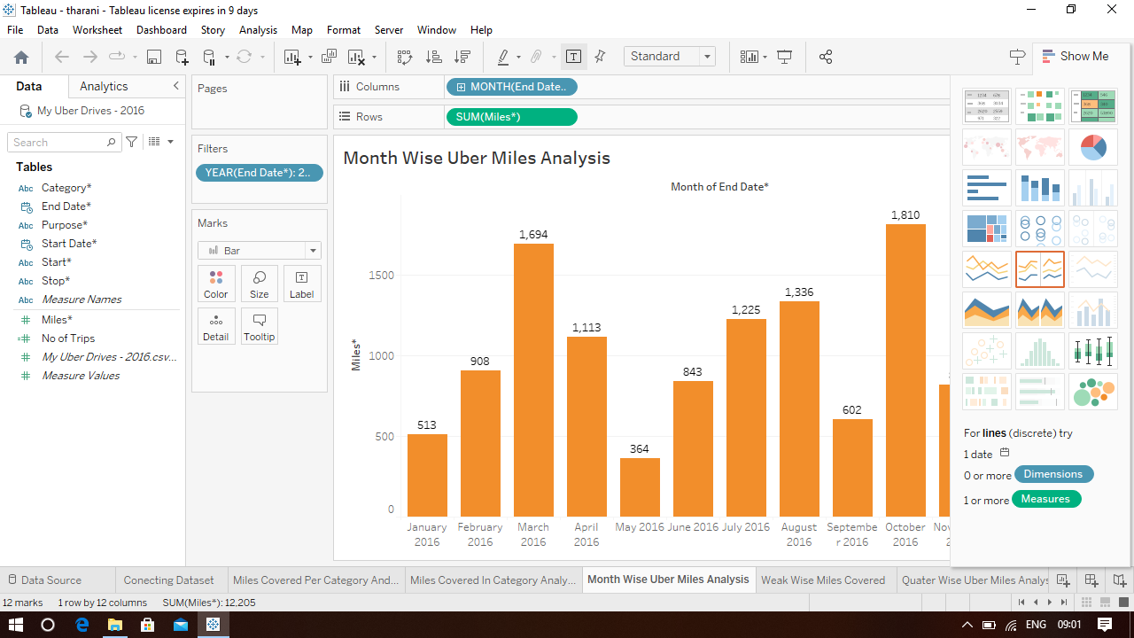
Month wise Uber Miles Analysis

Slide 11
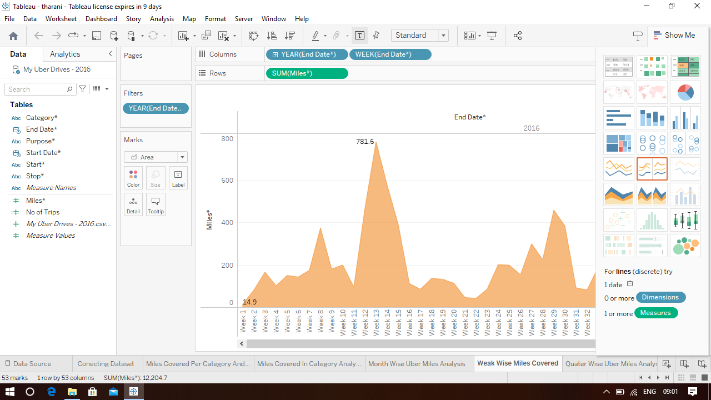
Week wise Uber Miles Analysis

Slide 12
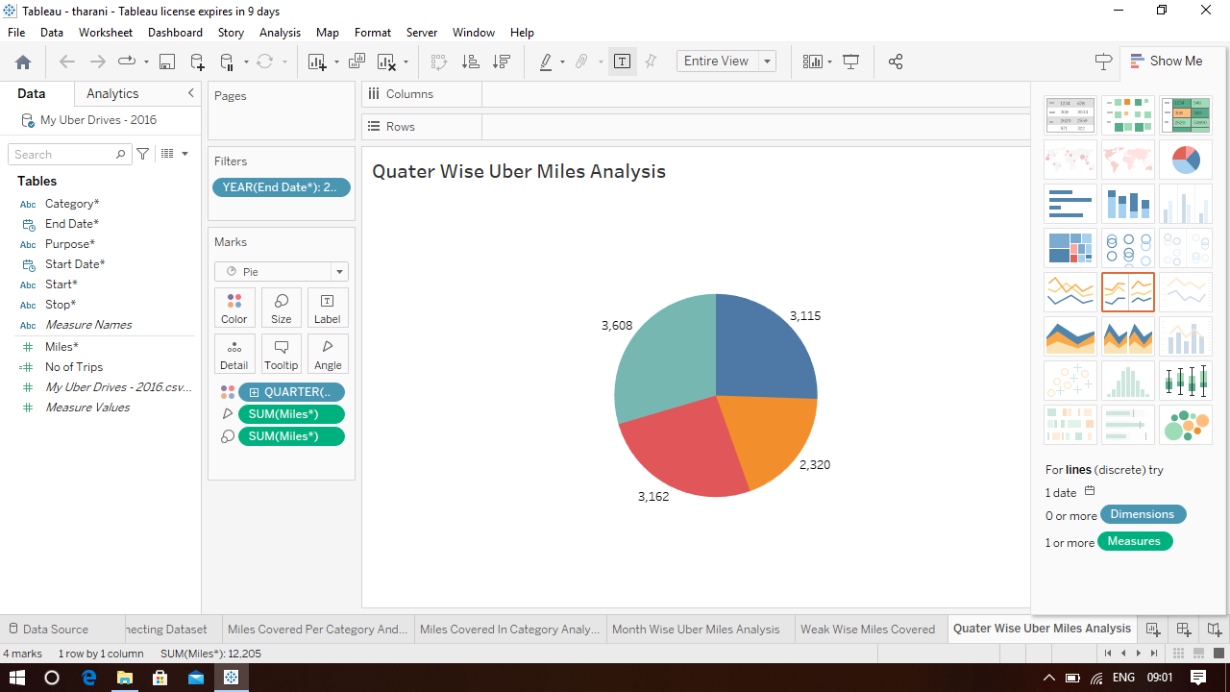
Quarter wise Uber Miles Analysis

Slide 13
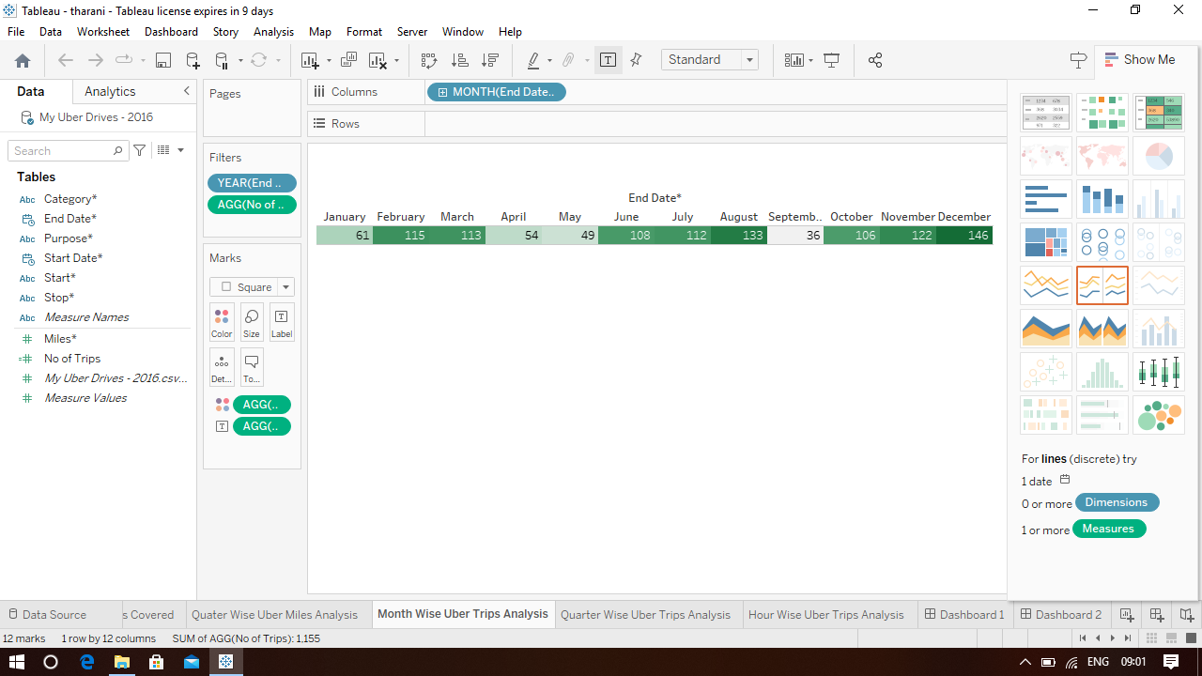
Month wise Uber Trips Analysis

Slide 14
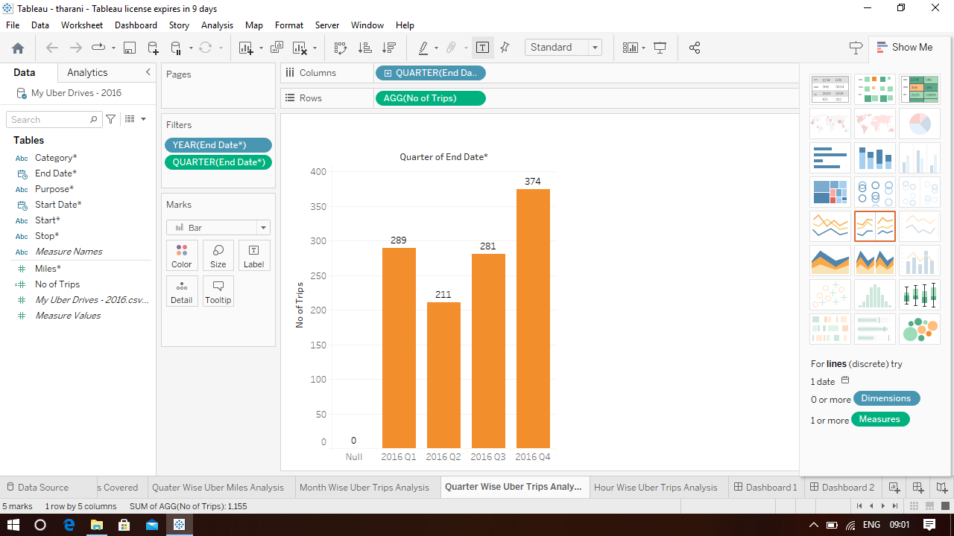
Quarter wise Uber Trips Analysis

Slide 15
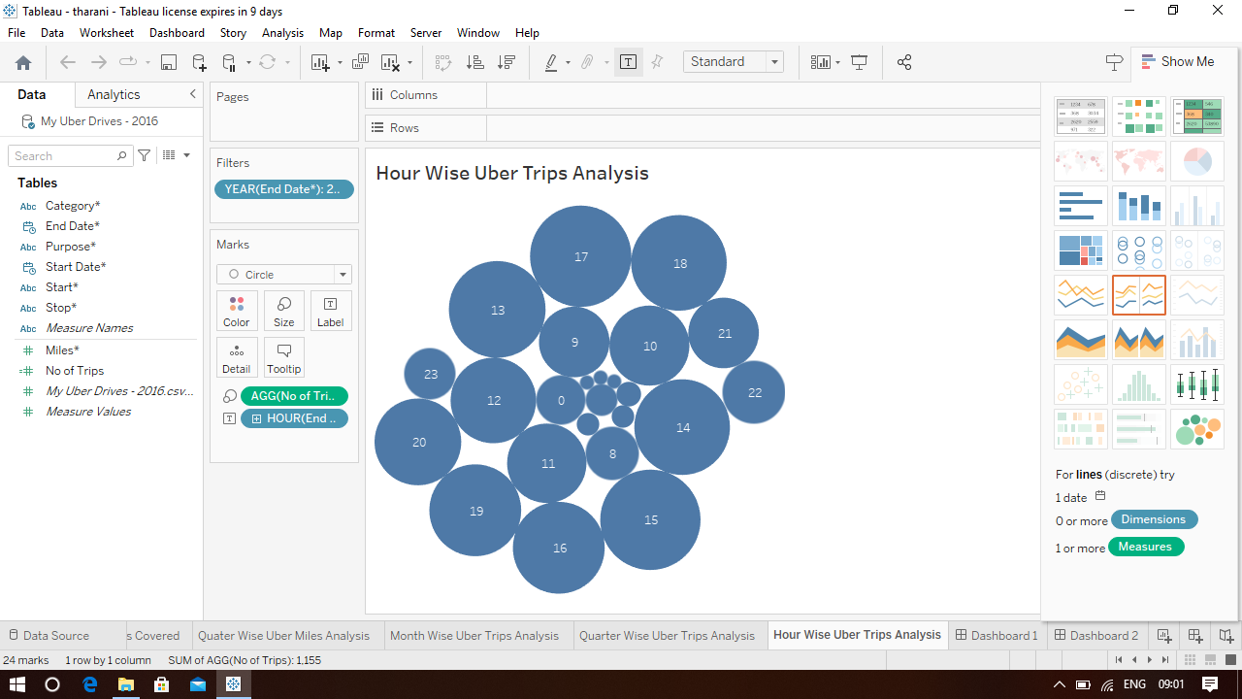
Hour wise Uber Trips Analysis

Slide 16
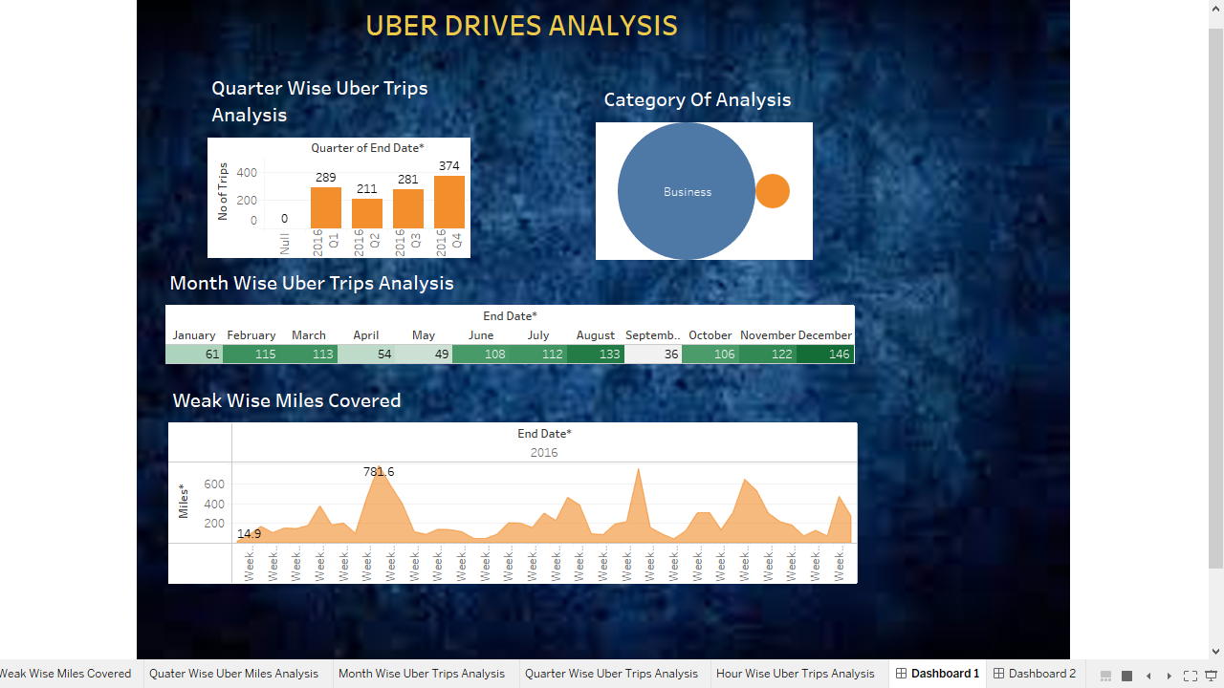
Dashboard 1
https://public.tableau.com/views/NM2023TMID08496/Dashboard1?:language=en-US&:display_count=n&:origin=viz_share_link

Slide 17
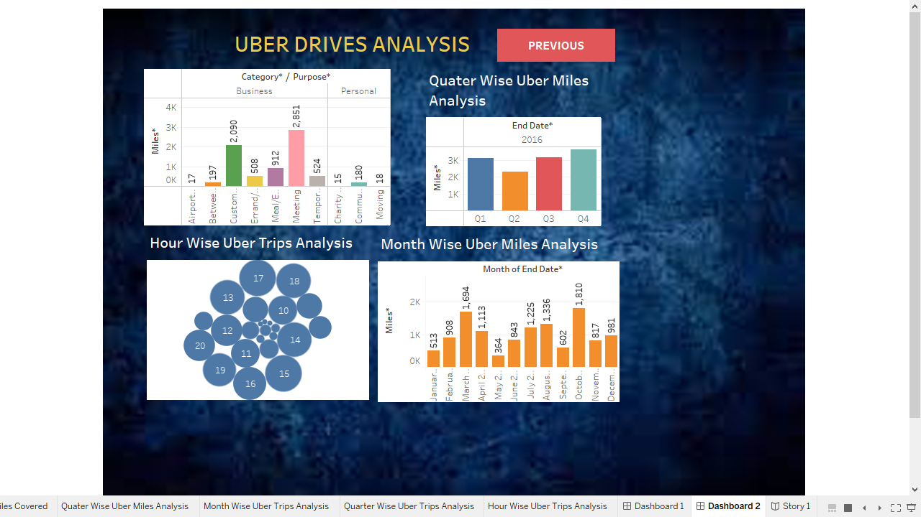
Dashboard 2
https://public.tableau.com/views/NM2023TMID08496-Dashboard2/Dashboard2?:language=en-US&:display_count=n&:origin=viz_share_link

Slide 18
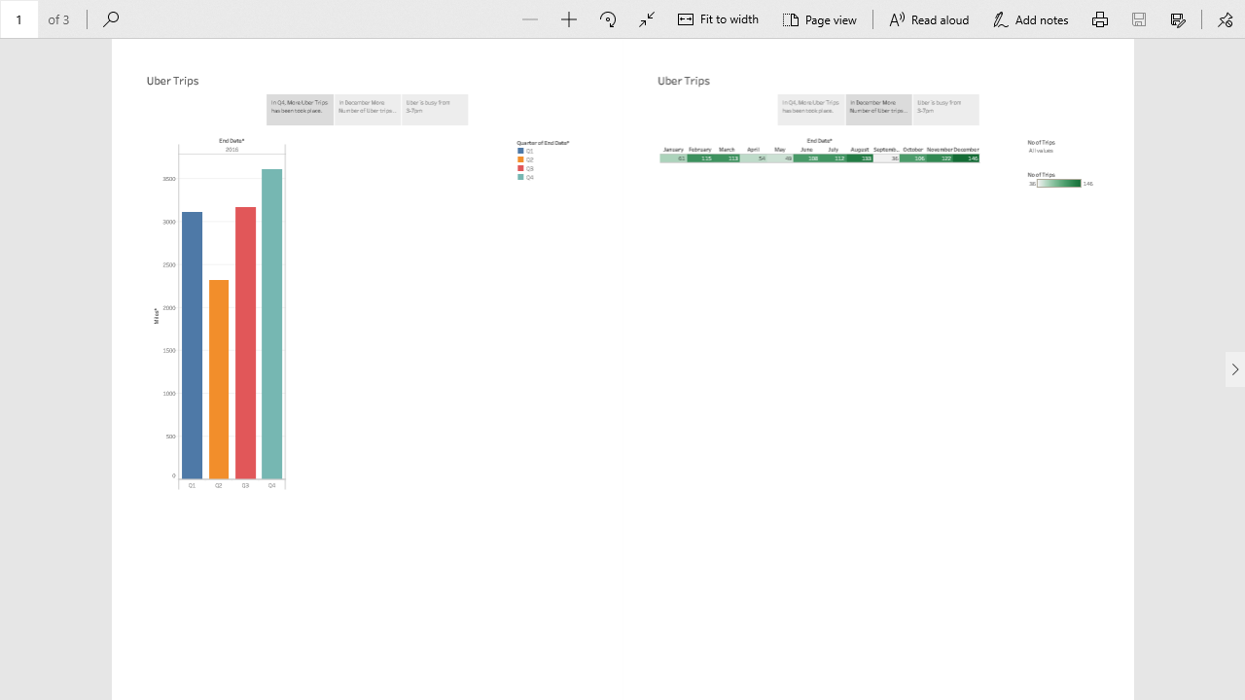
Story
https://public.tableau.com/views/NM2023TMID08496-Story/Story1?:language=en-US&:display_count=n&:origin=viz_share_link

Slide 19
CONCLUSION
In general, the example offered by Uber can be used by many developing companies. Nowadays, it is not a difficult task to create an organization and introduce some new, unusual services. However, it is always challenging to gain a good reputation, prove the quality of the services, and create appropriate working conditions.
Uber is the company with a complicated history. Still, its founders had made something that was impossible: they survived sabotages, strikes, and discontents of the governments of different countries around the whole world. The necessity to provide people with good services at affordable prices is urgent nowadays. Not all people are able to use the quality they want. Uber opens new perspectives and possibilities.

